Slide 1
AMBATI YAMINI
EMPLOYEE ID: 153040
JAVA FULL STACK, MIPL

Slide 2
CapStore Shopping Application

Slide 3
Project Requirements

Slide 4
Softwares:
Java 10
STS Version: 3.9.4.RELEASE
Eclipse Oxygen.3a (4.7.3a) platform
MySQL 5.5 Command Line Client
HTML 5
CSS 3
JavaScript
JSP
Spring Boot (2.0.4)
Spring Rest
Notes:
Fixar a posicao do titulo – sempre do lado esquerdo.
Sempre que tiver muito texto o coluna deve sempre ser “ narrowed” , se nao fica dificil de ler. Colocar paragrafos no texto.
Linha vertical deve ser mais fina e as pontas NUNCA devem ser arredondadas.

Slide 5
MODULE
GENERATING DISCOUNTS AND PROMOS

Slide 6
Generating Discount and Promo
Merchant will give discount to a particular product or promos to a customers at random.
Each discount or promo will have a unique id called discoundId which is autogenerated.
Either discountPercent or promoAmount will be zero.

Slide 7
INTERACTION WITH INVENTORY TABLE
INVENTORY(productid)
DISCOUNT

Slide 8
DISCOUNT DETAILS
Attribute Name | Data type | Constraint | Description
discountId | int | Primary key | Unique
discountPercent | int |  | No.of products
expiryDate | Date |  | End Date for promo or discount
issueDate | Date |  | Start Date for promo or discount
promoAmount | double |  | Amount
promoName | string |  | Name of the promo
productId | int | Foreign Key | References Inventory(productId)

Slide 9
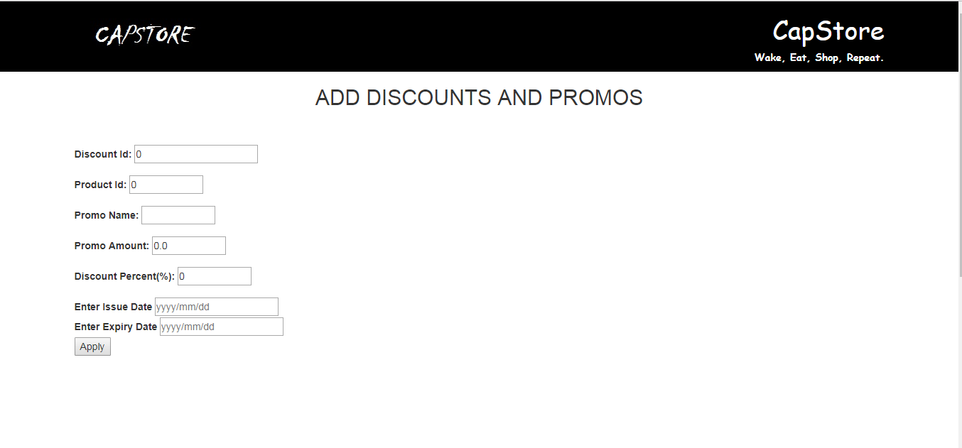
SCREENSHOT

Slide 10
Thank You
Notes:
O Box atras do texto desnecessario. Deixar o layout mais simples.

